Slide 1
Tableau
Building interactive dashboard

Slide 2
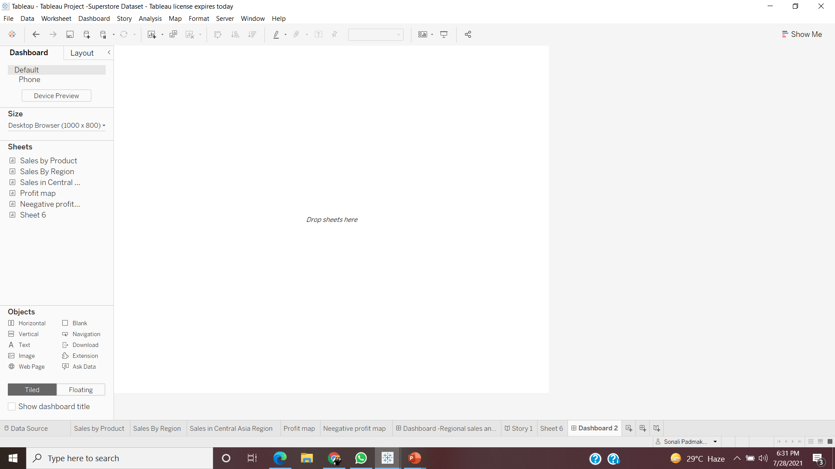
Build dashboard to show some insights.

Slide 3
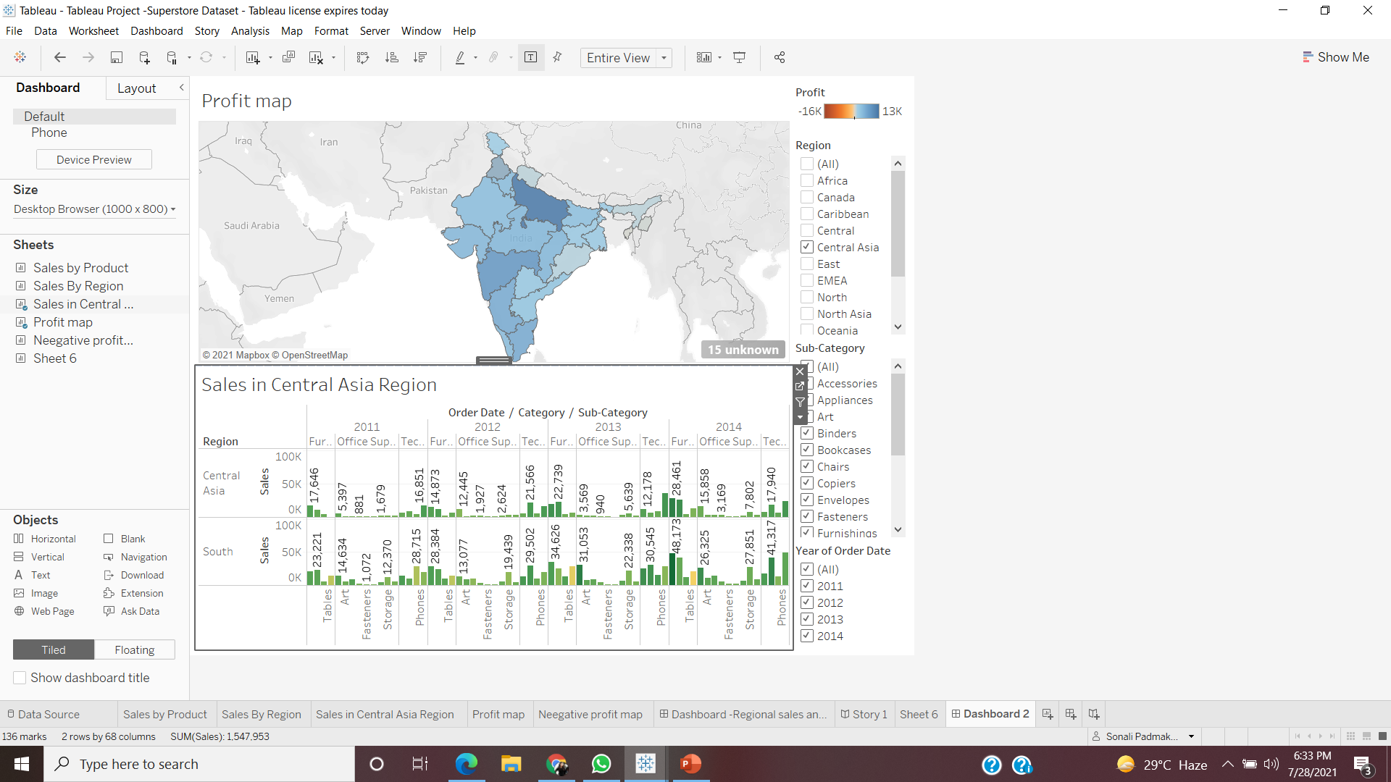
Arrange Your Dashboard.

Slide 4
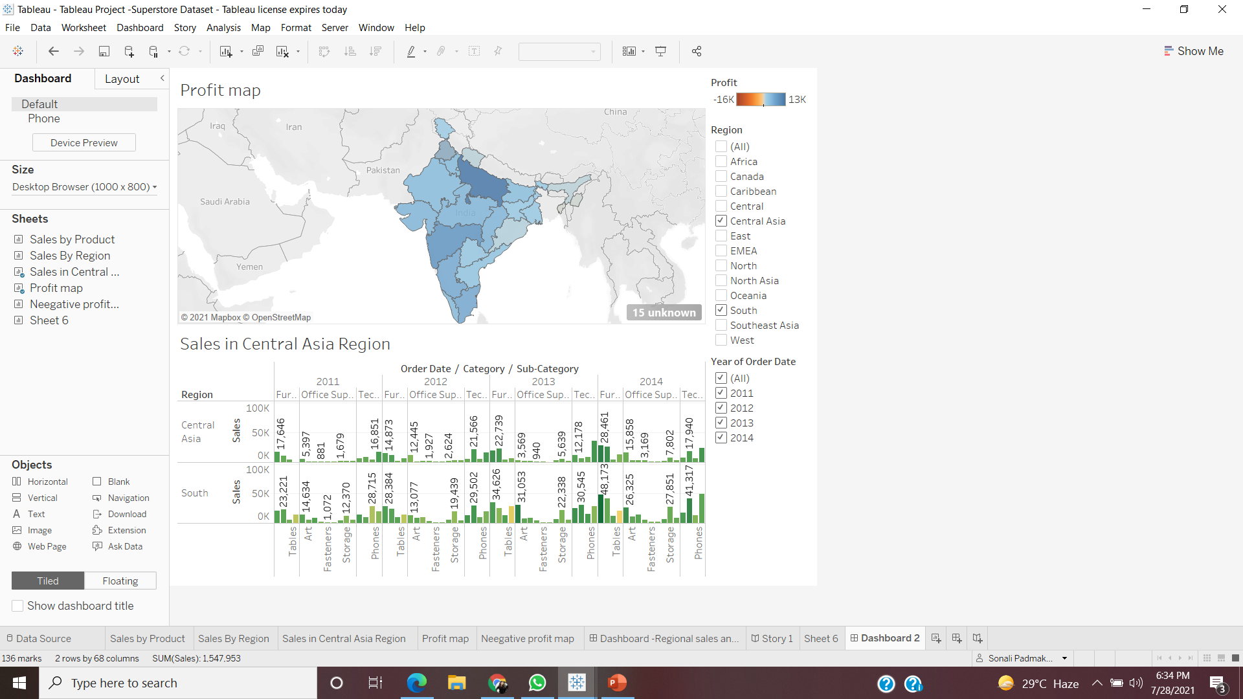
Remove the subcategory filter option to vacate the space.

Slide 5

Remove the year of order filter option to vacate the space

Slide 6
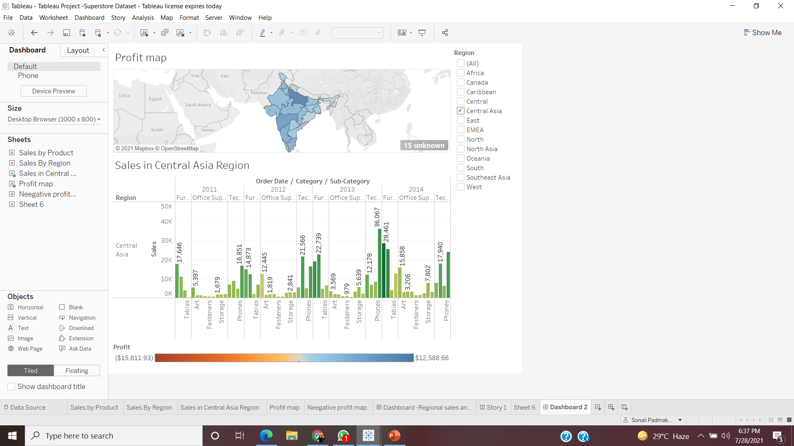
Select Profit color legend and drag it below to Sales in the South

Slide 7
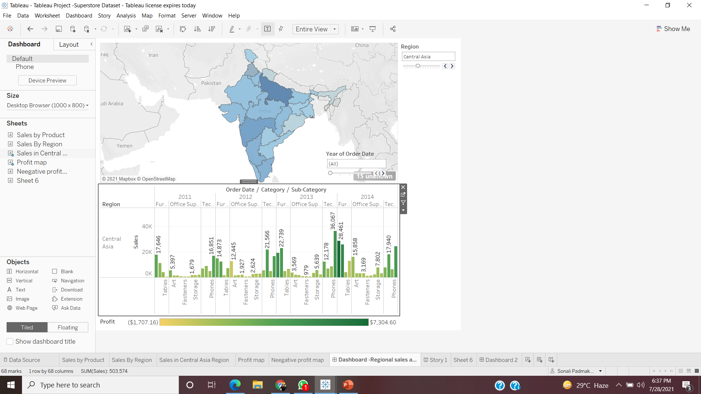
Make your dashboard interactive

Slide 8
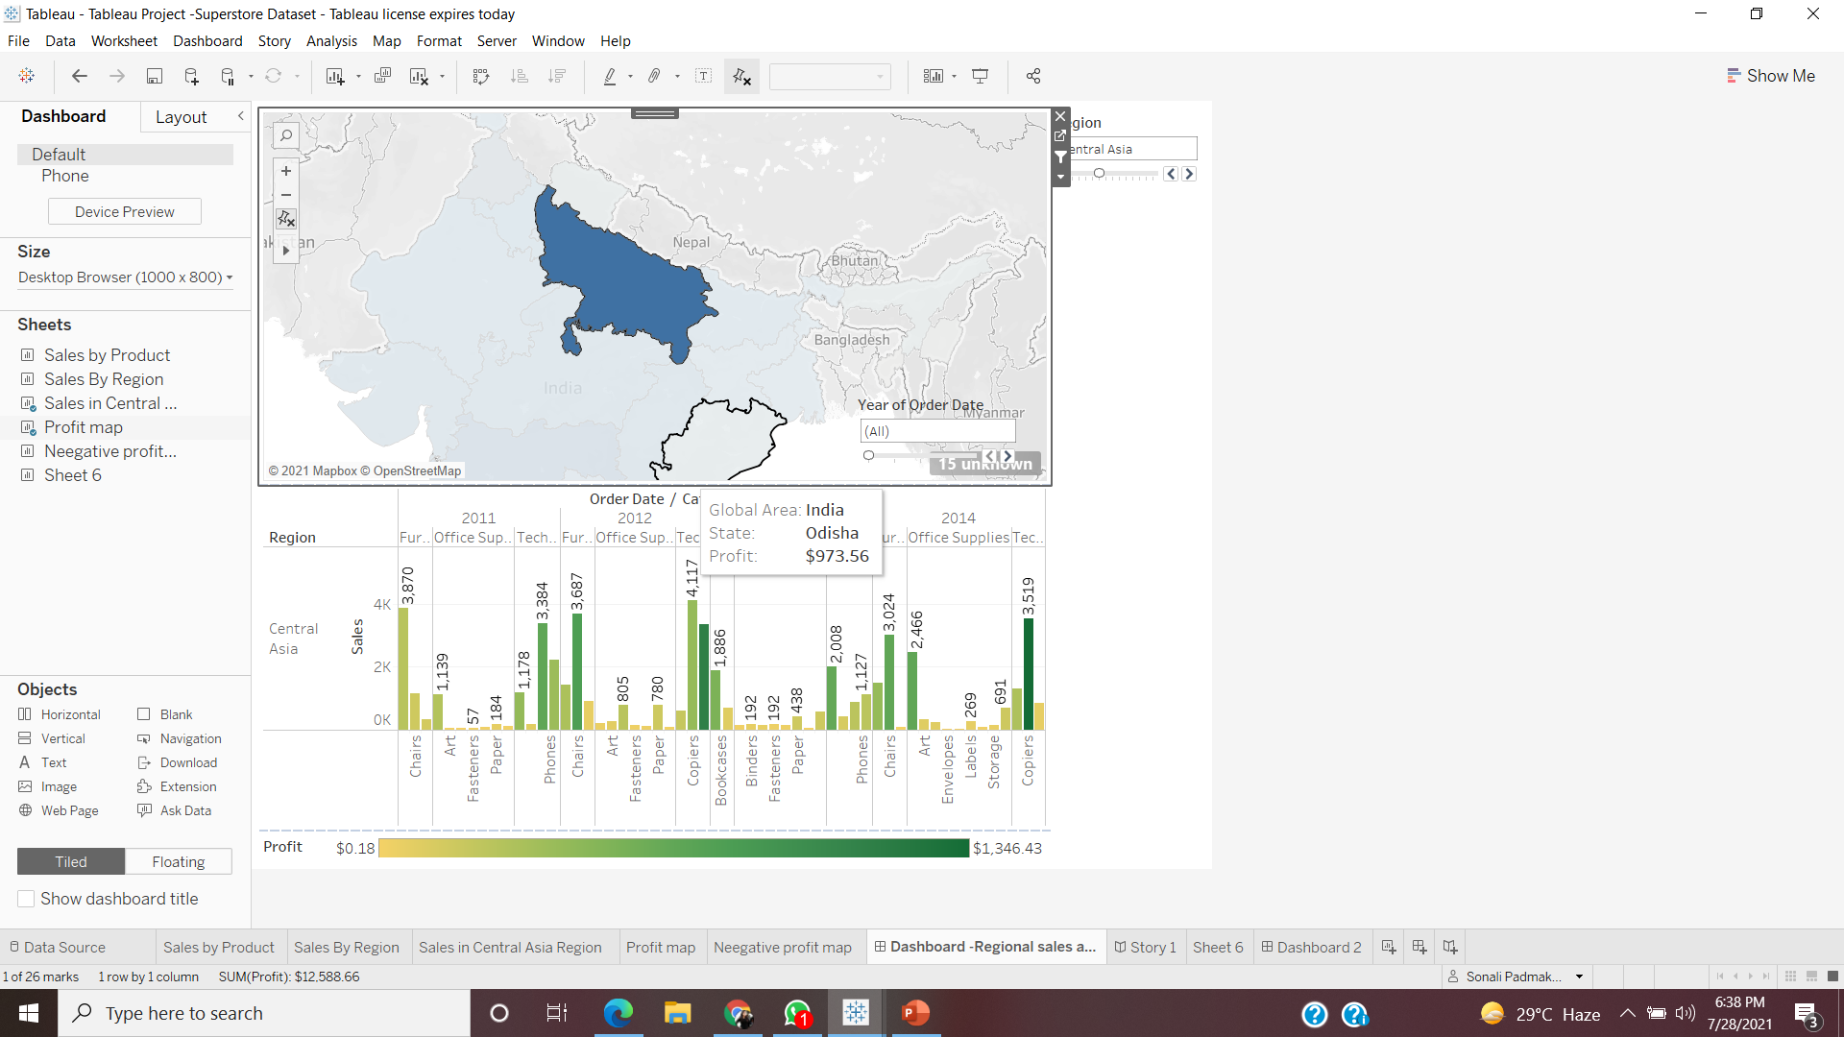
One by one click all the states in the profit map having negative profit and check both profit and sales for each state

Slide 9

Rename your dashboard and save as Regional Sales and Profit

